Slide 1
Satellites
Success Criteria
I can analyse the motion of satellites in circular orbits

Slide 2
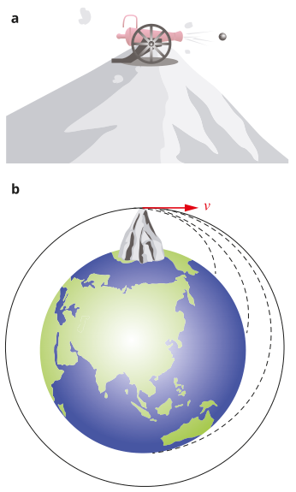
Newton’s Cannonball
Content Development
Isaac Newton had a famous thought experiment known as Newton’s Cannonball. He imagined a cannon sitting on a tall mountain. As the cannon is fired, the force of gravity pulls the cannonball down to Earth. But if you fire it faster, it will travel further before it lands.
If you can fire it fast enough, it would travel all the way around the Earth and reach its starting point again.
Calculate that velocity
(ignoring air resistance)
Step 1: draw a free-body diagram
Notes:
Fnet = mg = mv^2/r
v = sqrt(g*r) = sqrt ( 9.8 * 6.37*10^6) = 7901 m/s = 7.9 km/s = 28,462 km/h
https://en.wikipedia.org/wiki/Newton%27s_cannonball
https://spatrick.mit.edu/newtons-cannon
https://physics.weber.edu/schroeder/software/NewtonsCannon.html

Slide 3
Newton’s Cannonball
Content Development
The only force acting on the cannonball is gravity. The cannonball is also undergoing circular motion, therefore experiencing a centripetal force.
F_{g} = F_{c}
mg = mv²/r
Rearrange for v
$$v= √(gr)$$
For the Earth, g = 9.8 ms⁻² and r = 6.37*10⁶ m
v = 7.9 km/s = 7900 m/s
Note that it is independent of mass (assuming no air resistance)
Notes:
Fnet = mg = mv^2/r
v = sqrt(g*r) = sqrt ( 9.8 * 6.37*10^6) = 7901 m/s = 7.9 km/s = 28,462 km/h
https://en.wikipedia.org/wiki/Newton%27s_cannonball
https://spatrick.mit.edu/newtons-cannon
https://physics.weber.edu/schroeder/software/NewtonsCannon.html

Slide 4
Newton’s Cannonball
Content Development
https://en.wikipedia.org/wiki/Newton%27s_cannonball
https://spatrick.mit.edu/newtons-cannon
https://physics.weber.edu/schroeder/software/NewtonsCannon.html
Notes:
Fnet = mg = mv^2/r
v = sqrt(g*r) = sqrt ( 9.8 * 6.37*10^6) = 7901 m/s = 7.9 km/s = 28,462 km/h
https://en.wikipedia.org/wiki/Newton%27s_cannonball
https://spatrick.mit.edu/newtons-cannon
https://physics.weber.edu/schroeder/software/NewtonsCannon.html

Slide 5
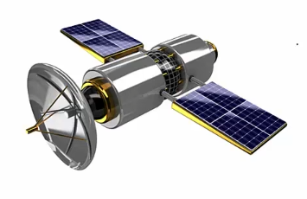


Satellite Motion
Content Development
F_{g} = F_{c}
$$\frac{GMm}{r^{2}}=\frac{mv^{2}}{r}$$
$$\frac{GMm}{r^{2}}=\frac{m4π^{2}r^{2}}{rT^{2}}$$
$$\frac{4π^{2}}{GM}=\frac{T^{2}}{r^{3}}$$
$v=\frac{2πr}{T}$
E
Kepler’s Third Law
LHS: constant RHS: orbital period and orbital radius
Notes:
Only force acting on the satellite is its weight force. This weight force is its centripetal force.
Note that this force isn’t ‘g’, as the satellite isn’t on the surface of the Earth and the effect of Earth’s gravitational field is weaker. You need to calculate Fg.
What would happen to the orbital period (how long it takes to complete an orbit) as the orbital radius increases (the distance from the object to the centre of the main body)?

Slide 6
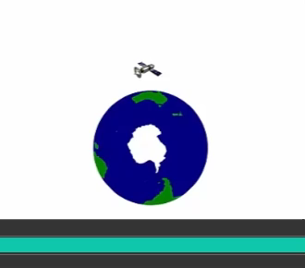
Satellite Motion
Content Development
Close to the Earth → short period
Orbits the Earth quicker than the Earth rotates
Far from the Earth → long period
Orbits the Earth slower than the Earth rotates
Just the right distance from the Earth → period of one day
Geosynchronous: period of satellite equals the rotation of the Earth. Orbit at the exact same time as the Earth rotates. Satellite stays in the same spot relative to the Earth.
Geosynchronous orbits

Slide 7
Satellite Motion
Content Development
Calculate the orbital radius of a geosynchronous satellite.
Notes:
T = 24k = 86400s
r^3 = GMT^2 / 4pi^2 = 7.530 * 10^22
r = 4.22*10^7m

Slide 8
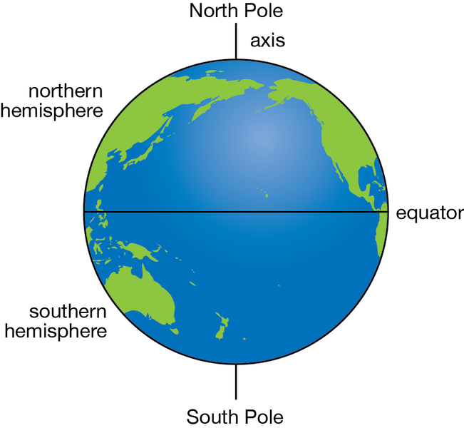

Satellite Motion
Content Development
Geostationary orbit:
A special type of geosynchronous orbit where the satellite’s orbital plane lies along the equatorial plane of the Earth.
These satellites appear stationary in the sky.
Geostationary
Geosynchronous
Notes:
Red = geostationary = does not move in the night sky
Yellow = geosynchronous = appears to move in the sky

Slide 9
Satellite Motion
Content Development
Satellite Uses
Low orbit (close to Earth): Hubble Space Telescope, some weather satellites, International Space Station, ocean current monitoring
Mid orbit: GPS
High orbit: Communications, some weather satellites

Slide 10
Satellite Motion
Content Development

Slide 11
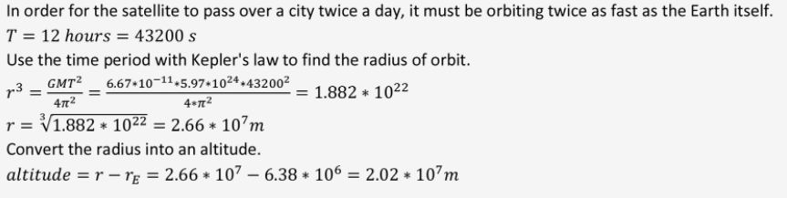
Satellite Motion
Content Development

Slide 12
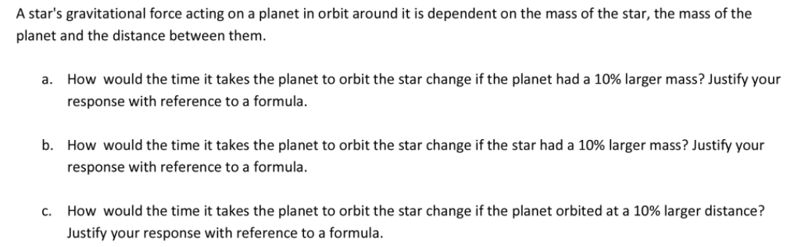
Satellite Motion
Content Development

Slide 13
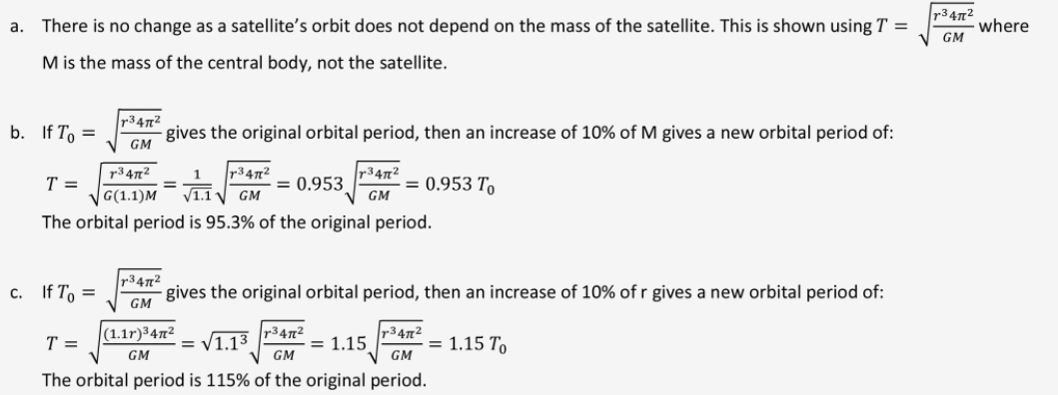
Satellite Motion
Content Development

Slide 14
Satellite Motion
Exam tips
Be comfortable working with algebra. Common questions ask you to use the orbital radius of one satellite to calculate the orbital radius of another, given the ratio of their orbital periods.
  Use subscripts to help you keep track of which piece of data you are using (e.g., r_{Mars})
If something is affected by more than one celestial body, the attraction forces to all bodies need to be considered. Always draw a free body diagram.
Know the definitions and differences between geosynchronous and geostationary satellites.
F_{g,A}
F_{g,A}
A
F_{c} = F_{g,A} - F_{g,B}
A
F_{c} = F_{g,A} + F_{g,B}
B
B
F_{g,B}
F_{g,B}

Slide 15
Satellites
Success Criteria
I can analyse the motion of satellites in circular orbits

Slide 16
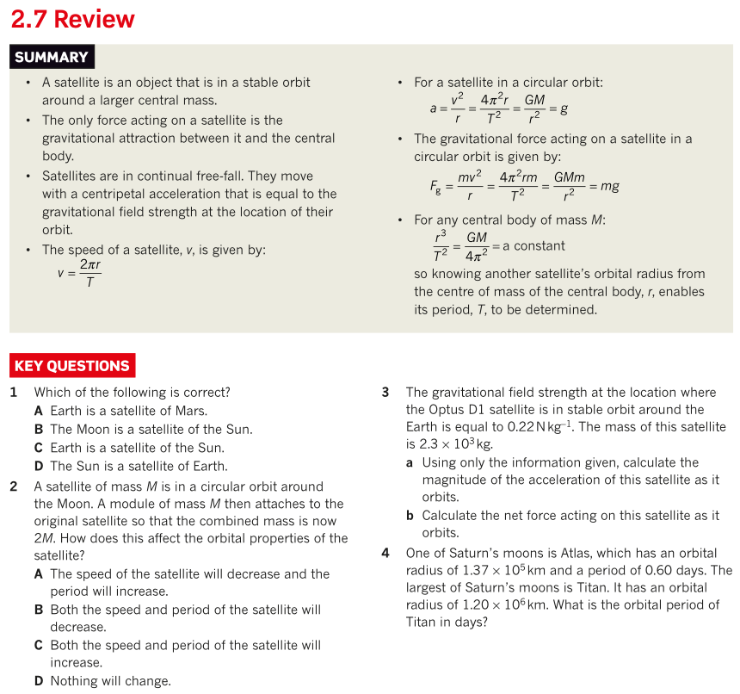
Satellite Motion
Additional Study

